Slide 1

Environment and Resource Economics
Lecture - 1
Seungho Jeon

Slide 2

Self-introduction

Slide 3
Name: 전승호, Seungho Jeon, 全勝鎬
Major: Energy Economics, 에너지경제학
Research Interest: Integrated Assessment Model (especially Global Change Assessment Model), Energy Modeling

Slide 4
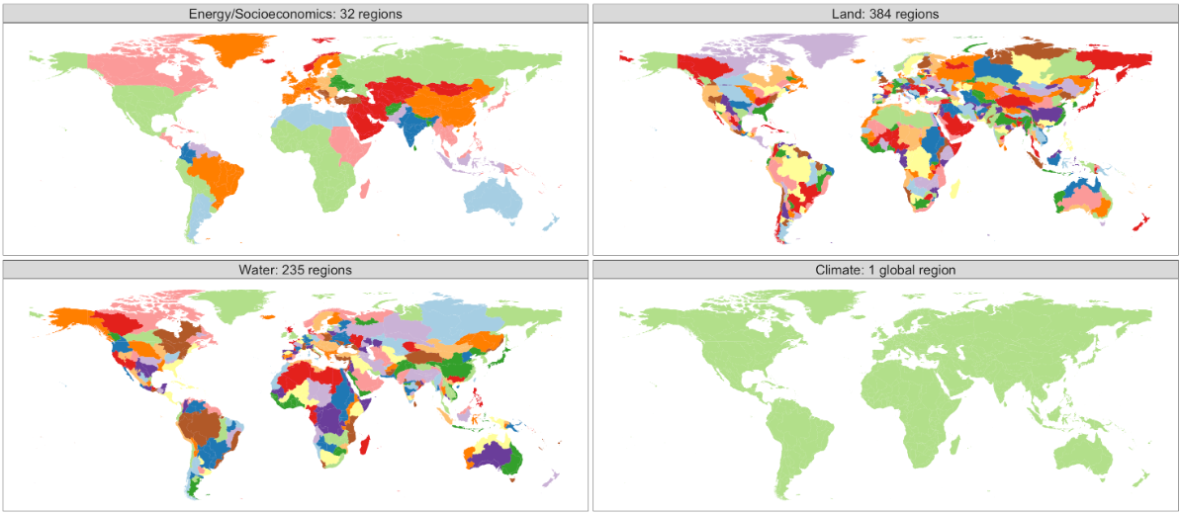
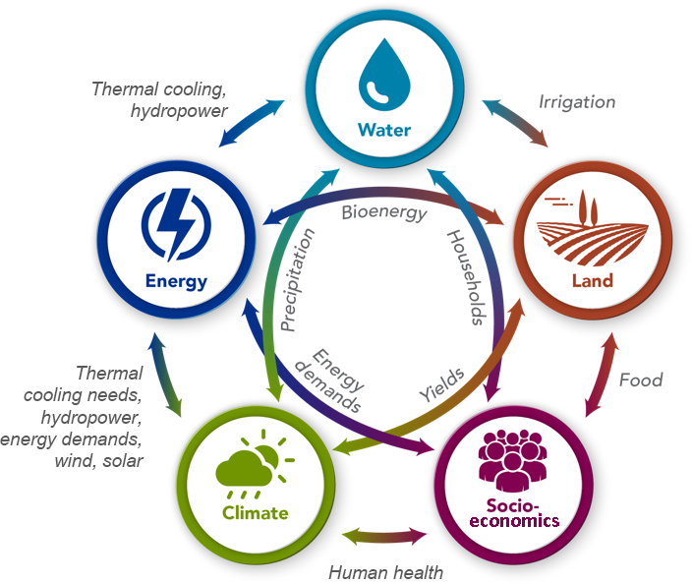
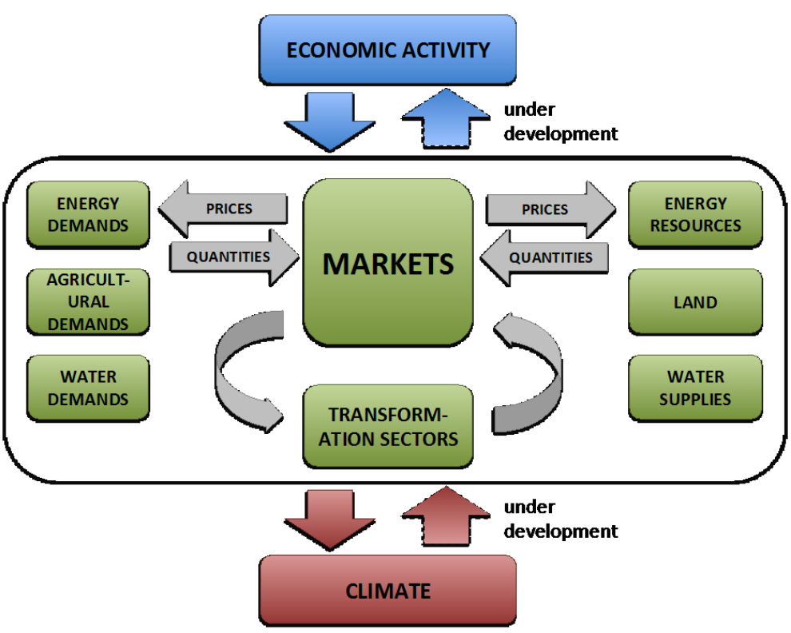
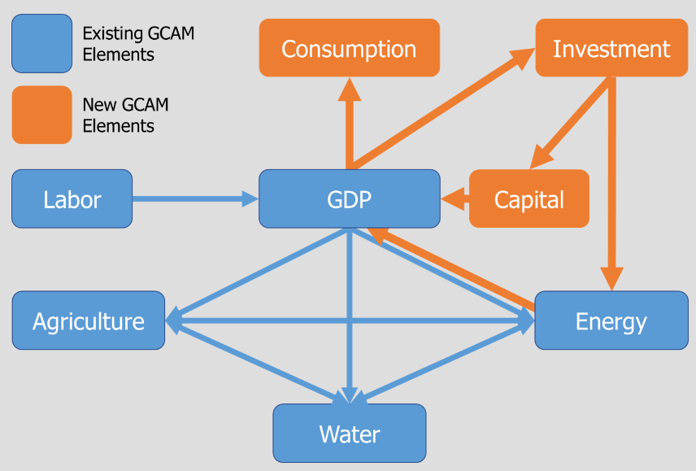
What is GCAM (Global Change Assessment Model)?
GCAM has been developed over the past 20 years at the PNNL¹⁾ in the United States
Energy Socioeconomics: 32 regions
Water basins: 235 regions
Land: 384 regions
Climate: 1 region
(IAM, Integrated assessment model) The model integrates multiple sectors including socioeconomics, energy, land-use, water, and climate systems
(Spatial resolution) It divides the world into 32 regions for socioeconomic and energy systems; South Korea is modeled as a single region
(Long-term projection) GCAM simulates in 5-year time steps from the base year 2015 to 2100
(Bottom-up model) It uses a bottom-up technology-rich structure to simulate systems at the technology level
(Equilibrium model) GCAM calculates equilibrium prices by balancing the supply and demand of resources across sectors (energy, land, water, etc.)
(Macroeconomic model) From version 7.0, GCAM incorporates GTAP²⁾ databases to construct a Social Accounting Matrix (SAM³⁾), which is then used for CGE⁴⁾-based macroeconomic interactions. This enables two-way interaction between the energy system and GDP, allowing analysis of how climate change affects macroeconomic activity
1) PNNL: Pacific Northwest National Laboratory
2) GTAP: Global Trade Analysis Project
3) SAM: Social Accounting Matrix
4) CGE: Computable General Equilibrium
Source: GCAM v.7.0 Documentation: GCAM Model Overview https://jgcri.github.io/gcam-doc/overview.html

Slide 5



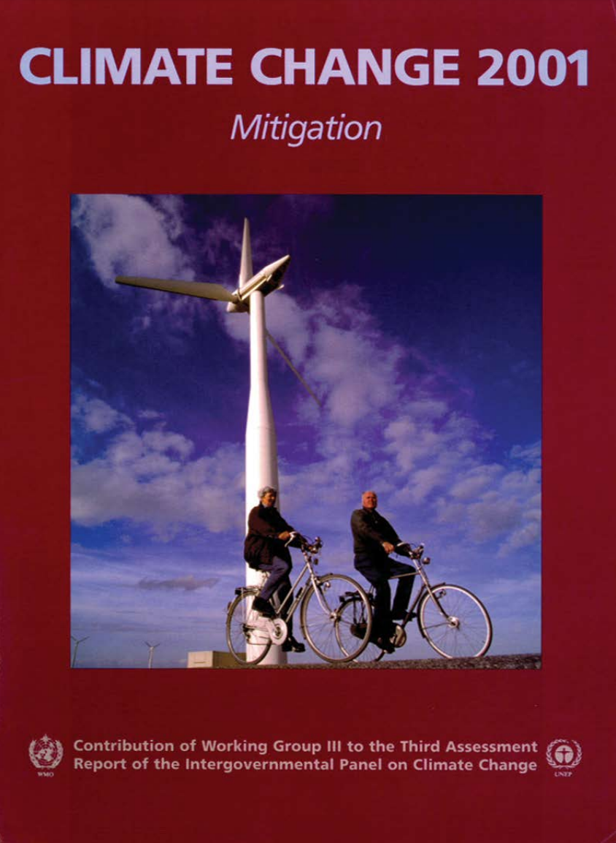
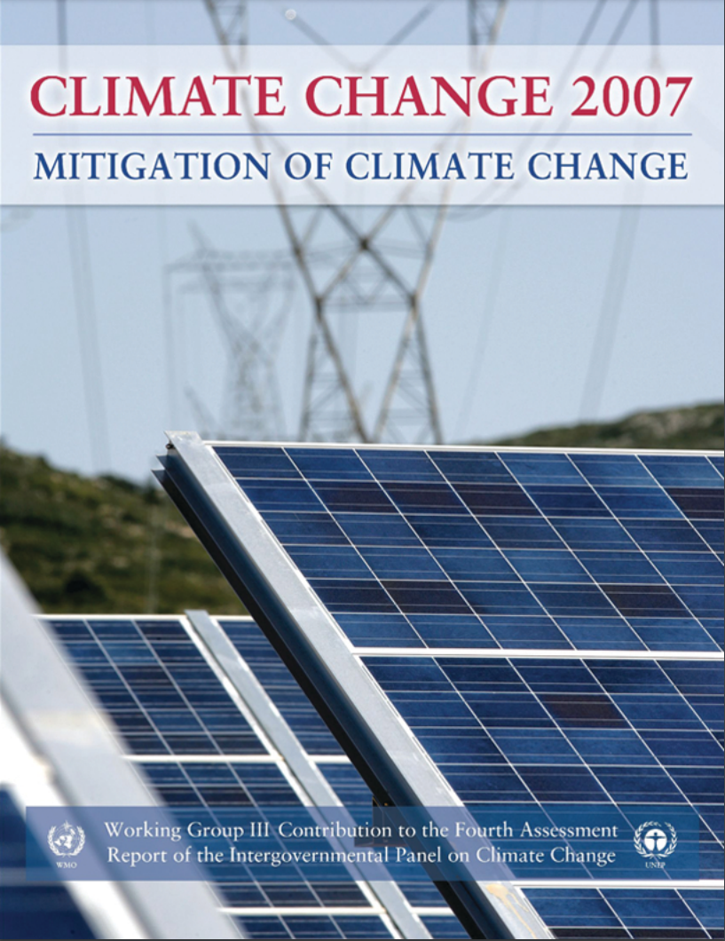
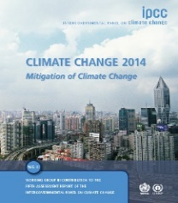
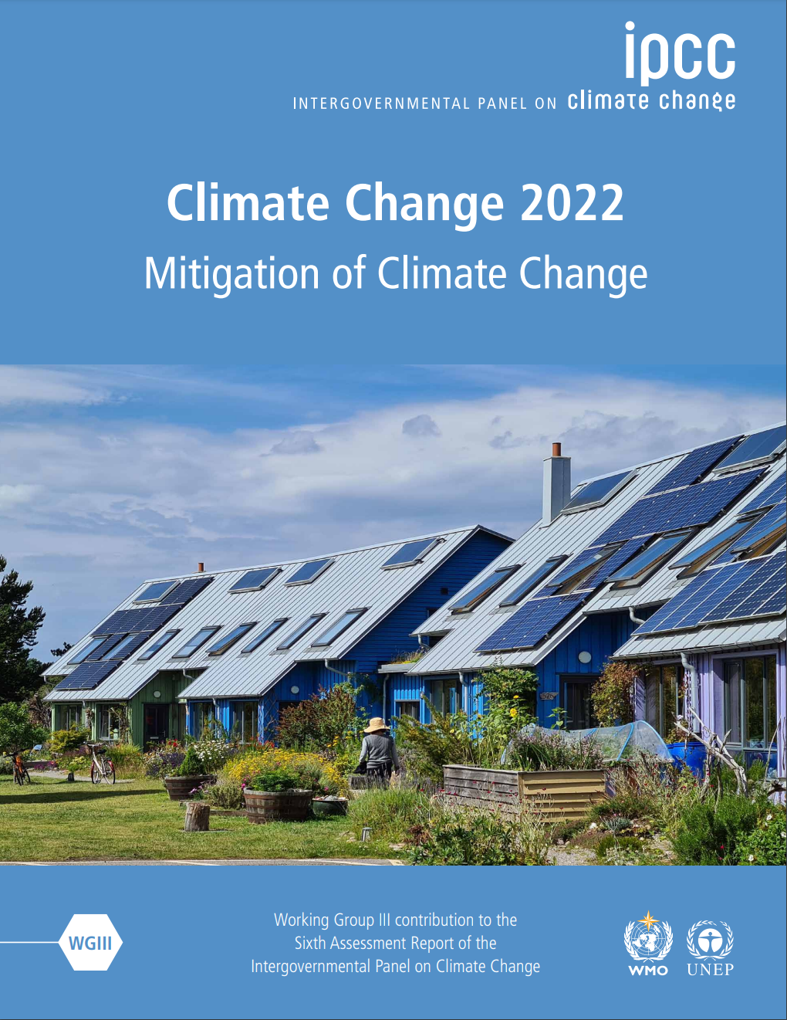

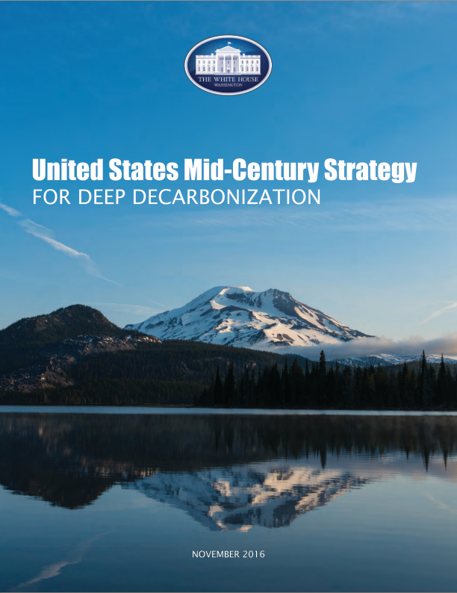
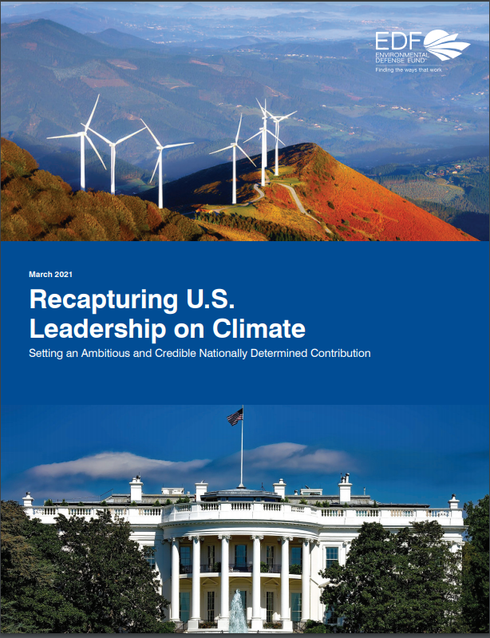
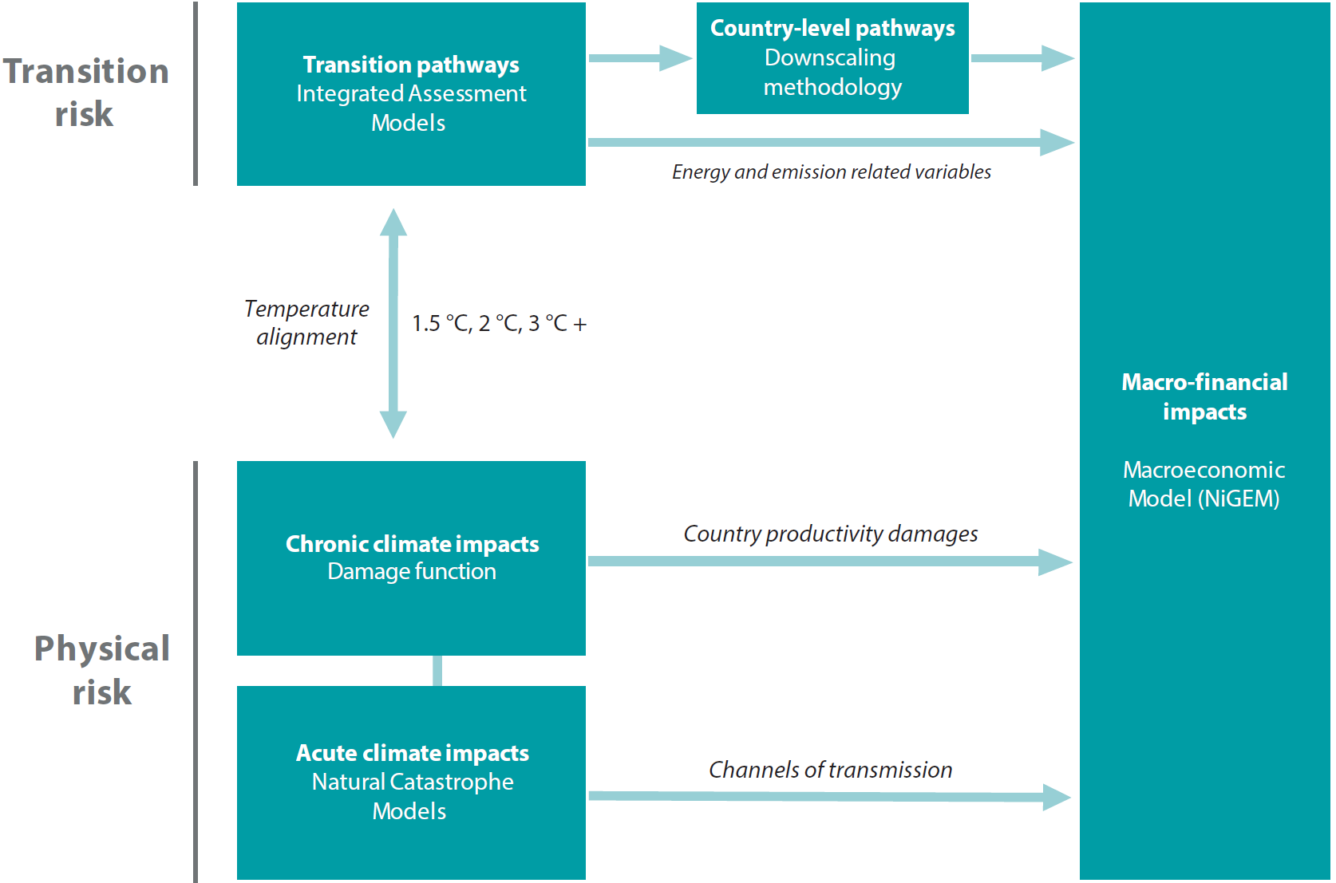

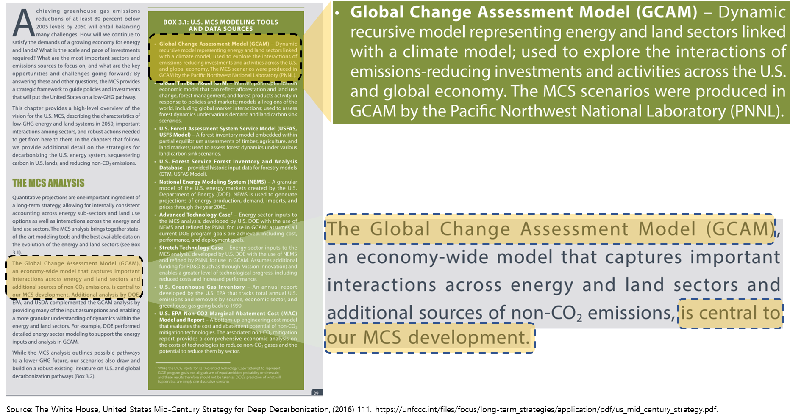
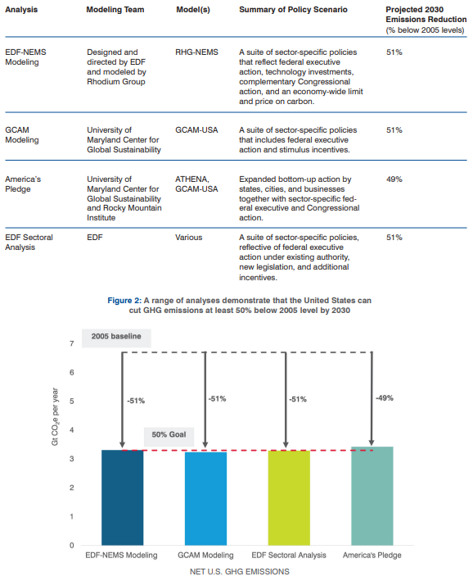
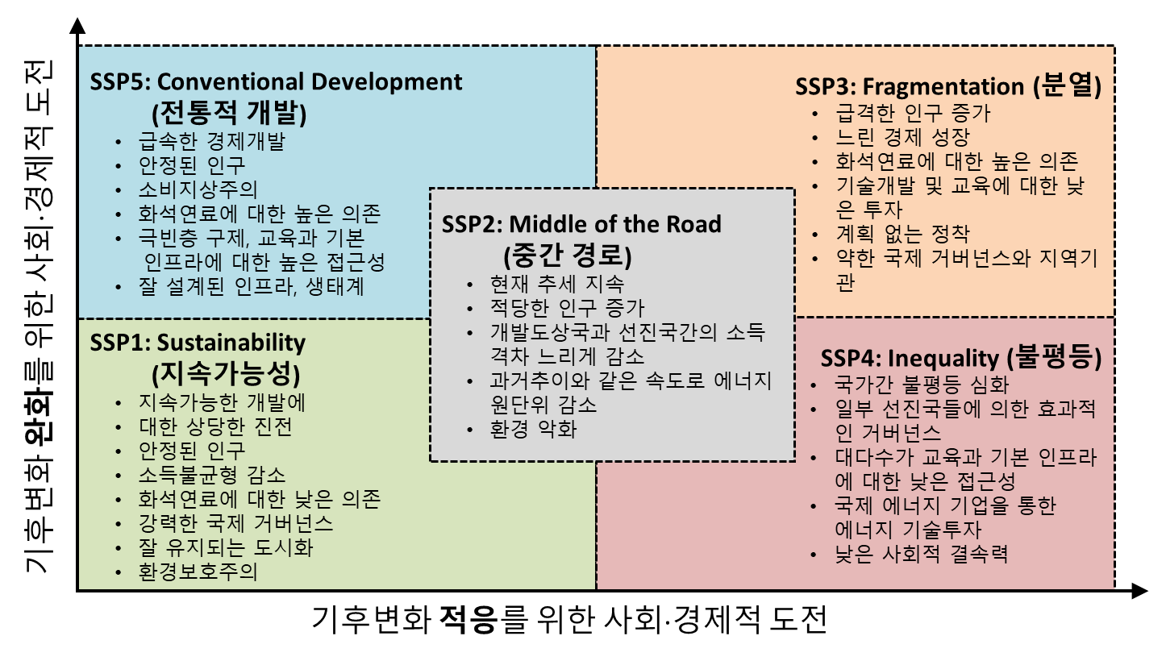
Why GCAM?
One of the main IAMs used in IPCC¹⁾ climate change scenario analyses
Used in U.S. national decarbonization strategies under the Obama administration
One of the three IAMs used in NGFS⁴⁾ transition risk analysis.
<Obama MCS²⁾ (2016)>
<EDF³⁾ Proposal (2021)>
Used by the Bank of Korea to analyze the
economic impact of climate change
<Impact of Climate Change on the Macroeconomy>
Source: IPCC, https://www.ipcc.ch/reports/
Used to develop SSP⁵⁾-RCP⁶⁾ scenarios GCAM is the marker model for SSP4
Source: NGFS, https://www.ngfs.net/ngfs-scenarios-portal/
1) IPCC: Intergovernmental Panel on Climate Change
2) MCS: Mid-Century Strategy
3) EDF: Environmental Defense Fund
4) NGFS: Network for Greening the Financial System
5) SSP: Shared Socioeconomic Pathways
6) RCP: Representative Concentration Pathways
Source: Kate Calvin. The GCAM Shared Socioeconomic Pathways(SSPs) 발표자료를 재구성.
Source: White House. https://unfccc.int/files/focus/long-term_strategies/application/pdf/mid_century_strategy_report-final_red.pdf
Source: Environmental Defense Fund (EDF). https://www.edf.org/sites/default/files/documents/Recapturing%20U.S.%20Leadership%20on%20Climate.pdf

Slide 6
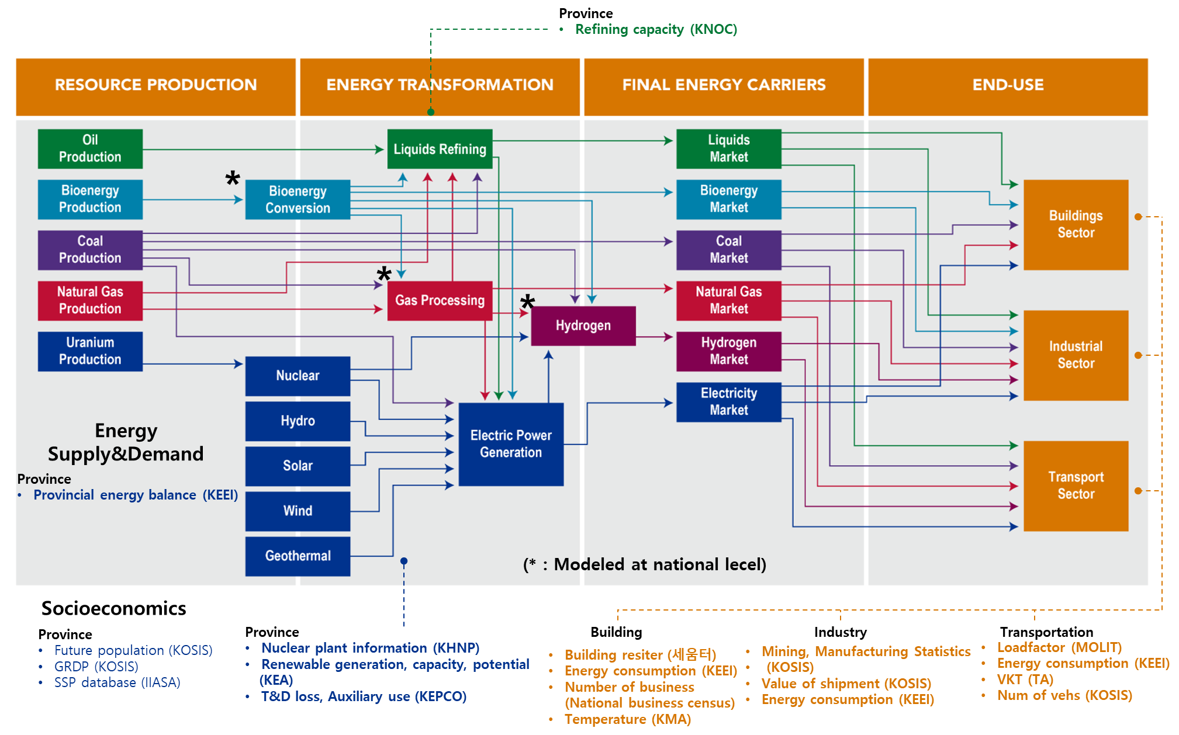
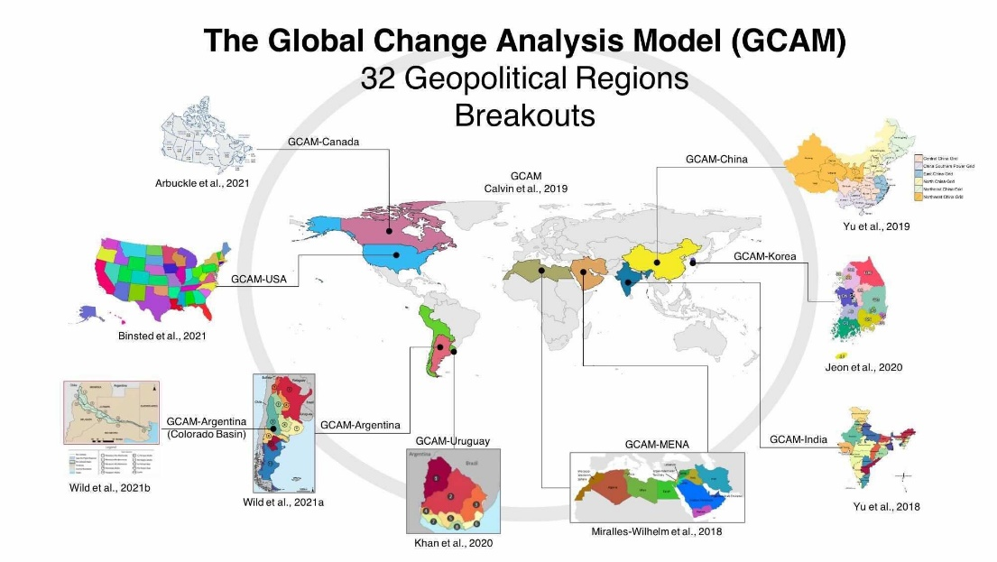
GCAM-Korea
Features of GCAM-Korea
(High resolution) Breaking down the energy system & socioeconomics of Korea into 17 provinces
(Global model) Still keeping the integrity of the global model.
(Open-source) Accessible on GitHub, enabling anyone to download it. https://github.com/EML-Ajou/GCAM-Korea
Energy systems in GCAM-Korea
South Korea
(17 provinces)
Source: JGCRI/PNNL, https://mobile.twitter.com/chris_r_vernon/status/1469435043068231688/photo/1
Source: Adapted GCAM v.7.0 Documentation - GCAM Model Overview, https://jgcri.github.io/gcam-doc/overview.html

Slide 7
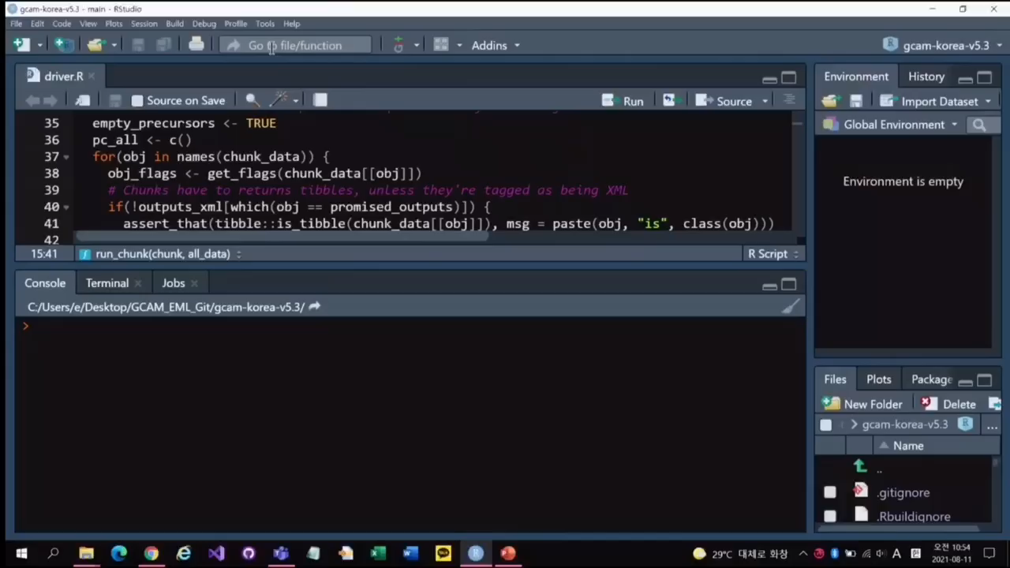
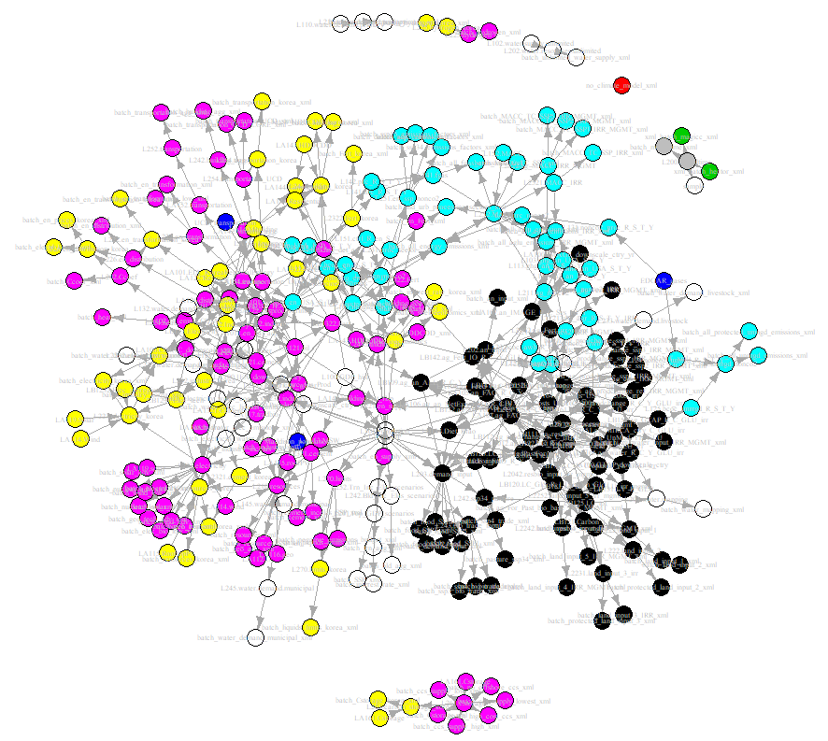



Data Science in GCAM-Korea
Data System
Through a process that entails 330 R modules, data gathered from diverse sources undergoes preprocessing and transformation into XML¹⁾ files
Part A: Input Data Generation
Energy
동영상 자료
Water
CSV
CSV
Language: R
Climate
Language: C++
Socioeconomics
Agriculture and land use
baseX
CSV
baseX
baseX
Raw Data
Over 580 CSV²⁾ files including parameters and data sourced from international organizations such as IEA³⁾, IMF⁴⁾, UN⁵⁾ and others are utilized in GCAM
Input Data
Input data(*.xml) follows a consistent set of rules and has a hierarchical structure. It is structured into around 130 XML files
Output Data
Simulation results is stored in the baseX file (or XML). The results could be extracted by using either R or Model Interface.
1) XML: eXtensible Markup Language
2) CSV : Comma Separated Values
3) IEA: International Energy Agency
4) IMF: International Monetary Fund
5) UN: United Nations
Part B: GCAM simulation
Core System
Model runs, finding international equilibrium prices that balance supply and demand in all markets

Slide 8
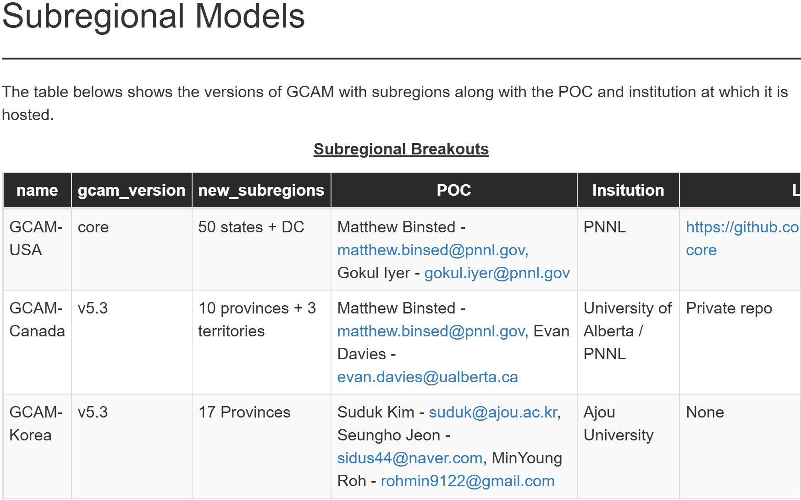
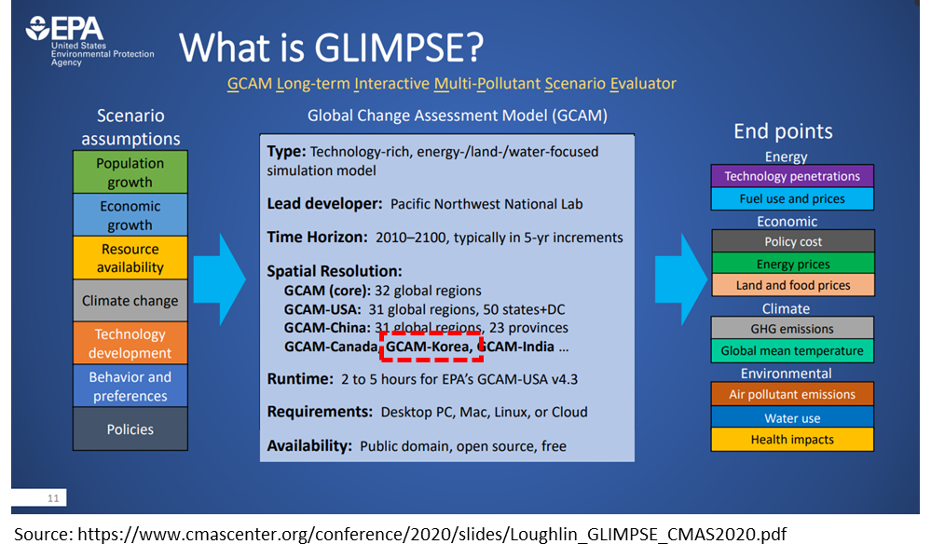
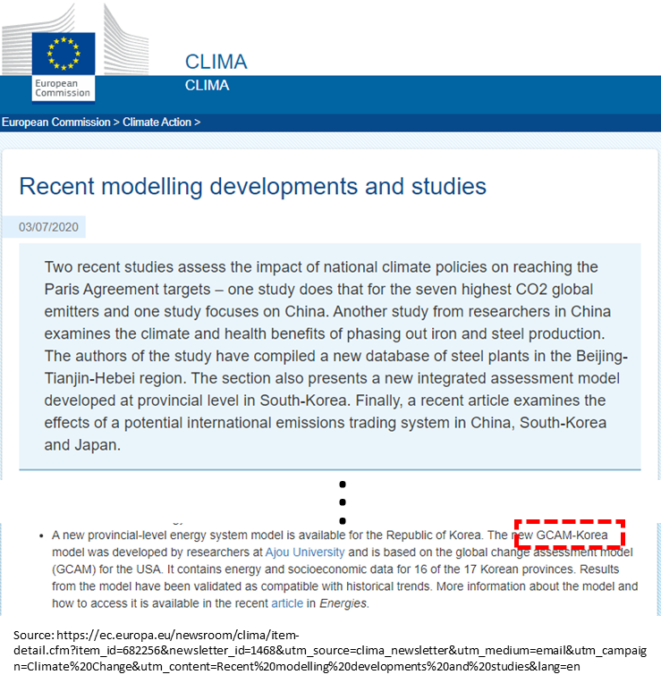
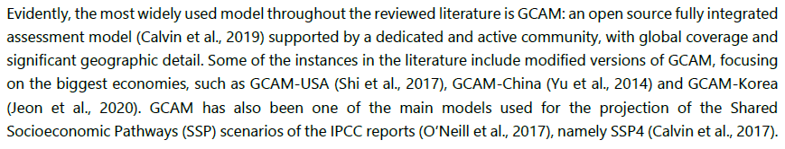
Novelty of GCAM-Korea
Official Introduction of GCAM Subregional Model
PARIS REINFORCE
U.S. Environmental Protection Agency
European Commission
Subregional GCAM Models
Source: https://jgcri.github.io/gcambreakout/articles/regional.html
Literature review of modeling
Source: https://paris-reinforce.eu/sites/default/files/2021-07/D7.3%20-%20Report%20on%20stakeholder%20needs%20and%20research%20capacity%20needed_v1.10R_REVISED.pdf
High spatial resolution model
Source: https://www.cmascenter.org/conference/2020/slides/Loughlin_GLIMPSE_CMAS2020.pdf
Literature review of modeling
Source: https://ec.europa.eu/newsroom/clima/items/682256

Slide 9
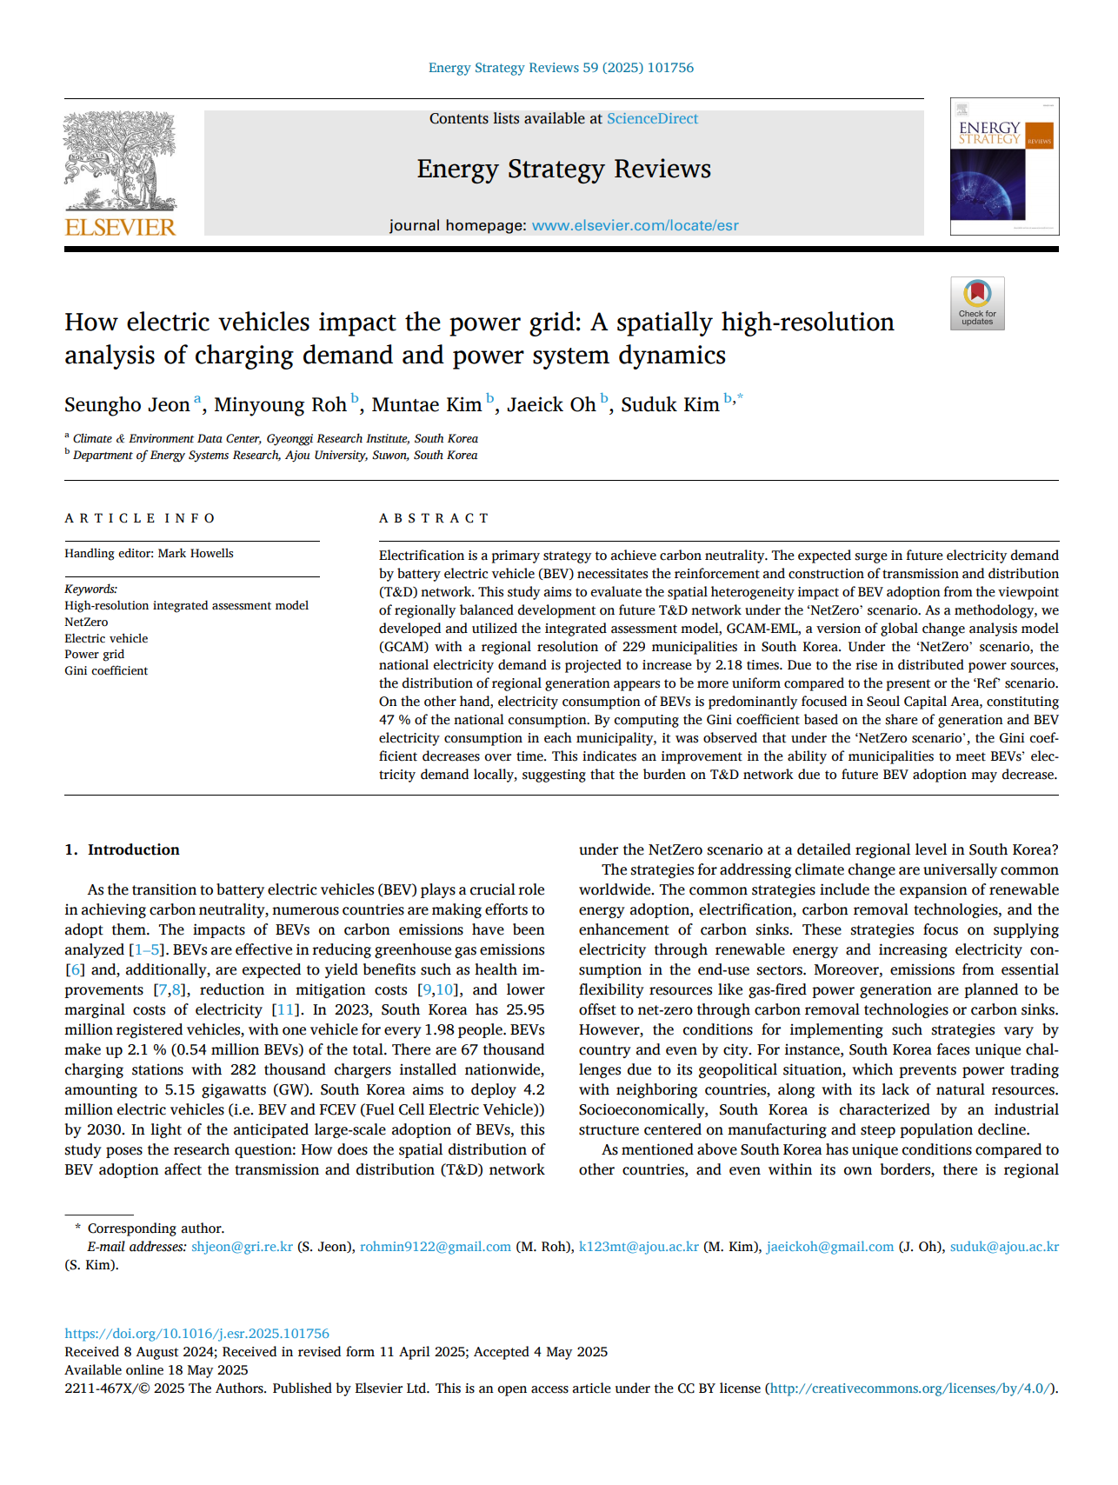
Power grid implications of electrification (2025)
Research Question How does electric vehicle (EV) adoption affect the national grid?
Background |  | Spatial mismatch between power supply and demand Expansion of EVs raises concerns over insufficient transmission infrastructure
Scenario |  | (Reference) No mitigation policies are implemented (business as usual) (NetZero) Mitigation policies in place to achieve net-zero emissions by 2050
Main findings |  | Spatial mismatch is reduced as supply becomes more balanced
 | Power Supply |  |  | Power Demand
 | Retirement of coal-fired power plants Nationwide expansion of solar PV Power supply becomes spatially balanced |  |  | Population is assumed to remain concentrated in the capital region EV adoption is concentrated in the capital region. Power demand from EVs remains spatially concentrated.
Implications |  | Spatial coordination of power supply-demand Electrification does not necessarily worsen grid stress if supply becomes spatially distributed.

Slide 10
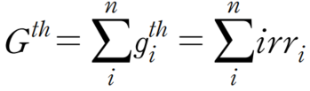
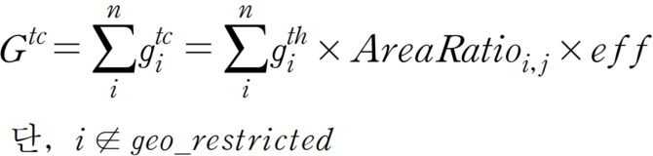
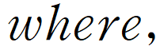
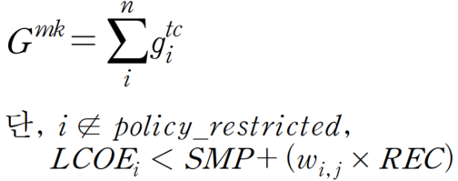
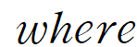
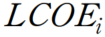
Spatial Analysis of solar PV (Jeon, 2025)
Research Question How much solar PV potential is economically usable and utilized?
Background | Gyeonggi-do has the highest electricity demand but a relatively low level of renewable generation
Method | GIS (Geographic Information System) spatial analysis based on satellite imagery irradiance data (1.5km raster) Three-tier PV potential assessment (Theoretical > Technical > Market potential) Economic viability based on LCOE vs. SMP (System Marginal Price)+REC (Renewable Energy Certificate) threshold using land prices at grid-level Municipality-level utilization rates assessed (Actual generation ÷ market potential)
Main findings | Large spatial disparities in utilization rates Gwangju : 147.1%, Paju : 2.2%
Implications | Policy attention is needed for underutilized but high-potential areas (e.g. Yeonchoen)
<Theoretical potential>
<Technical potential>
<Market potential>
: theoretical potential in Gyeonggi-do (MWh)
: theoretical potential of each grid cell ( ) (MWh)
: irradiance (MWh/year/100m²)
: technical potential in Gyeonggi (MWh)
: technical potential of each grid cell ( ) (MWh)
: panel coverage ratio (%)
: module efficiency (%)
: geographically restricted area
: politically restricted area
: levelized cost of electricity of each grid cell ( ) (MWh)
: system marginal price (won/kWh)
: renewable energy certificate (won/kWh)
: REC weight (unitless)
국립한밭대학교 2025학년도 제1차 전임교원 공개채용 | 경제학과 자원·환경·에너지 분야 | 전 승 호

Slide 11
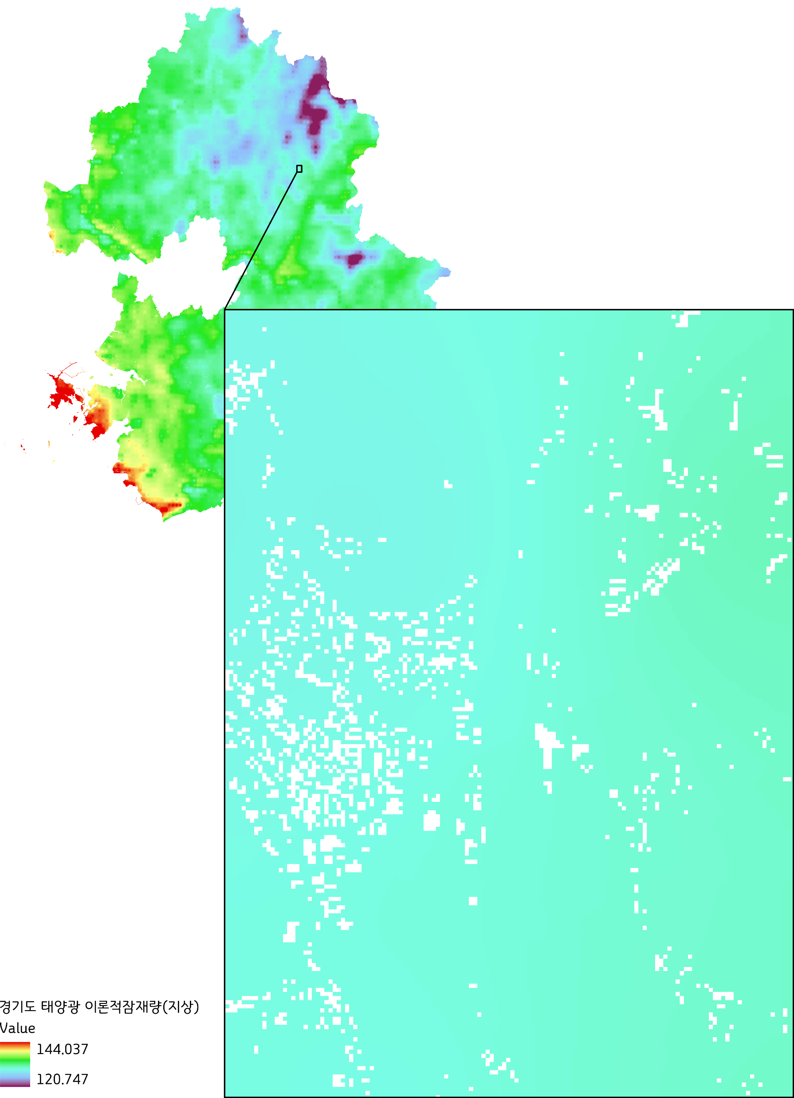
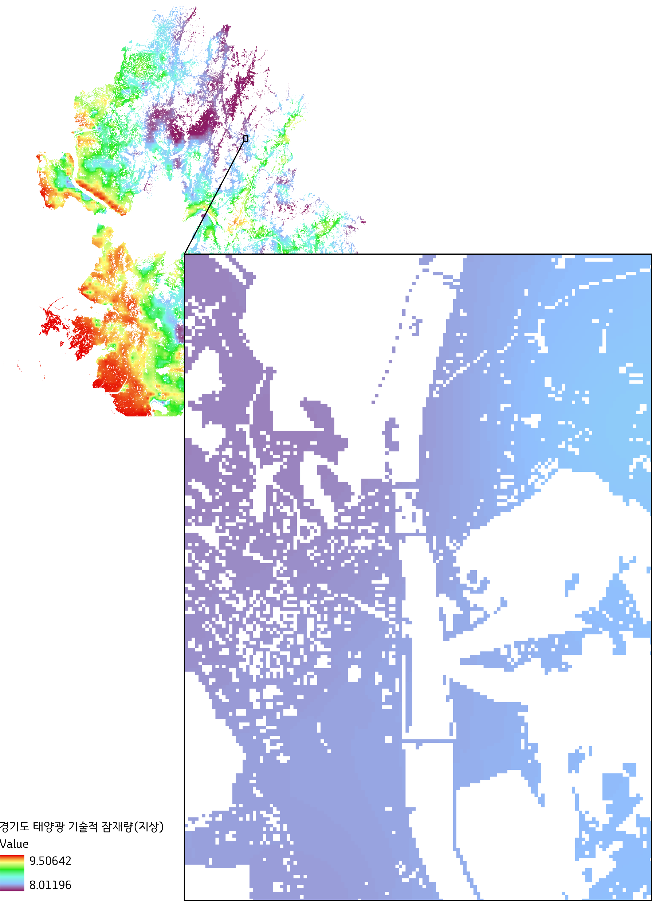
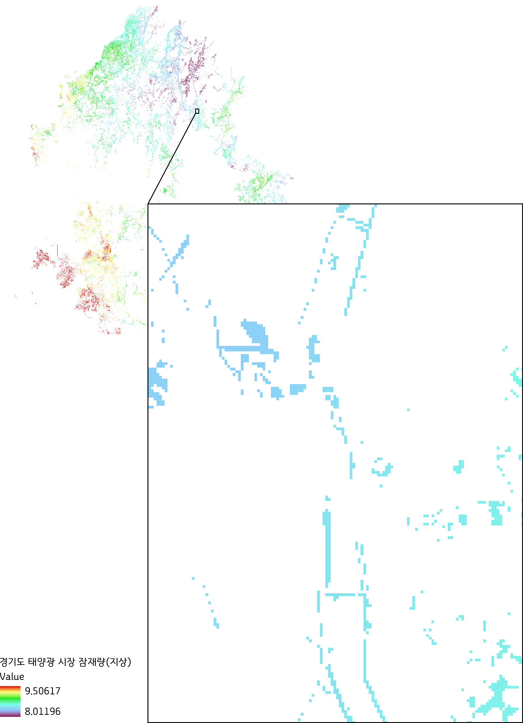
Spatial Analysis of solar PV (Jeon, 2025)- Solar PV potential in Gyeonggi
Theoretical potential
Technical potential
Market potential
(MWh/year/m²)
(MWh/year/m²)
(MWh/year/m²)
Source: Author
Source: Author
Source: Author
국립한밭대학교 2025학년도 제1차 전임교원 공개채용 | 경제학과 자원·환경·에너지 분야 | 전 승 호

Slide 12
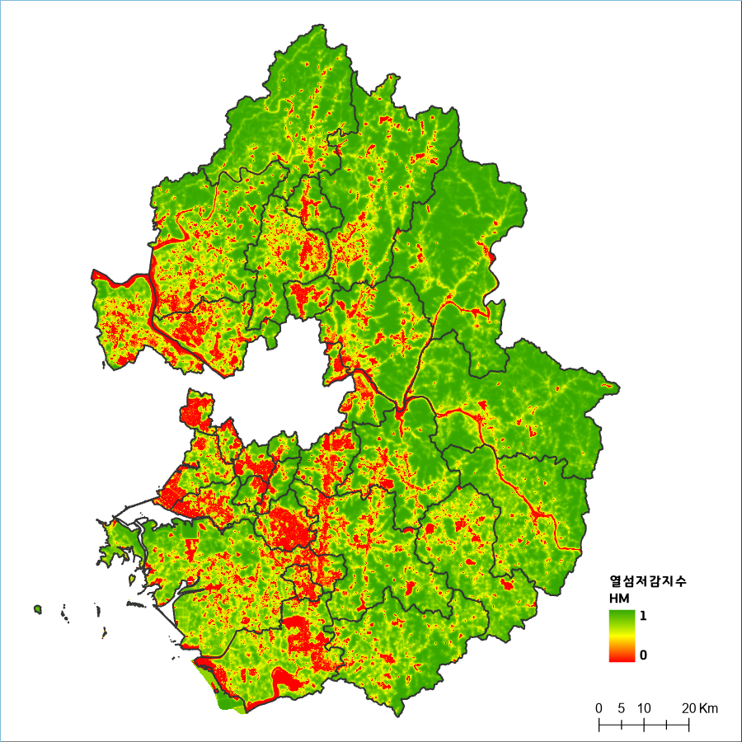
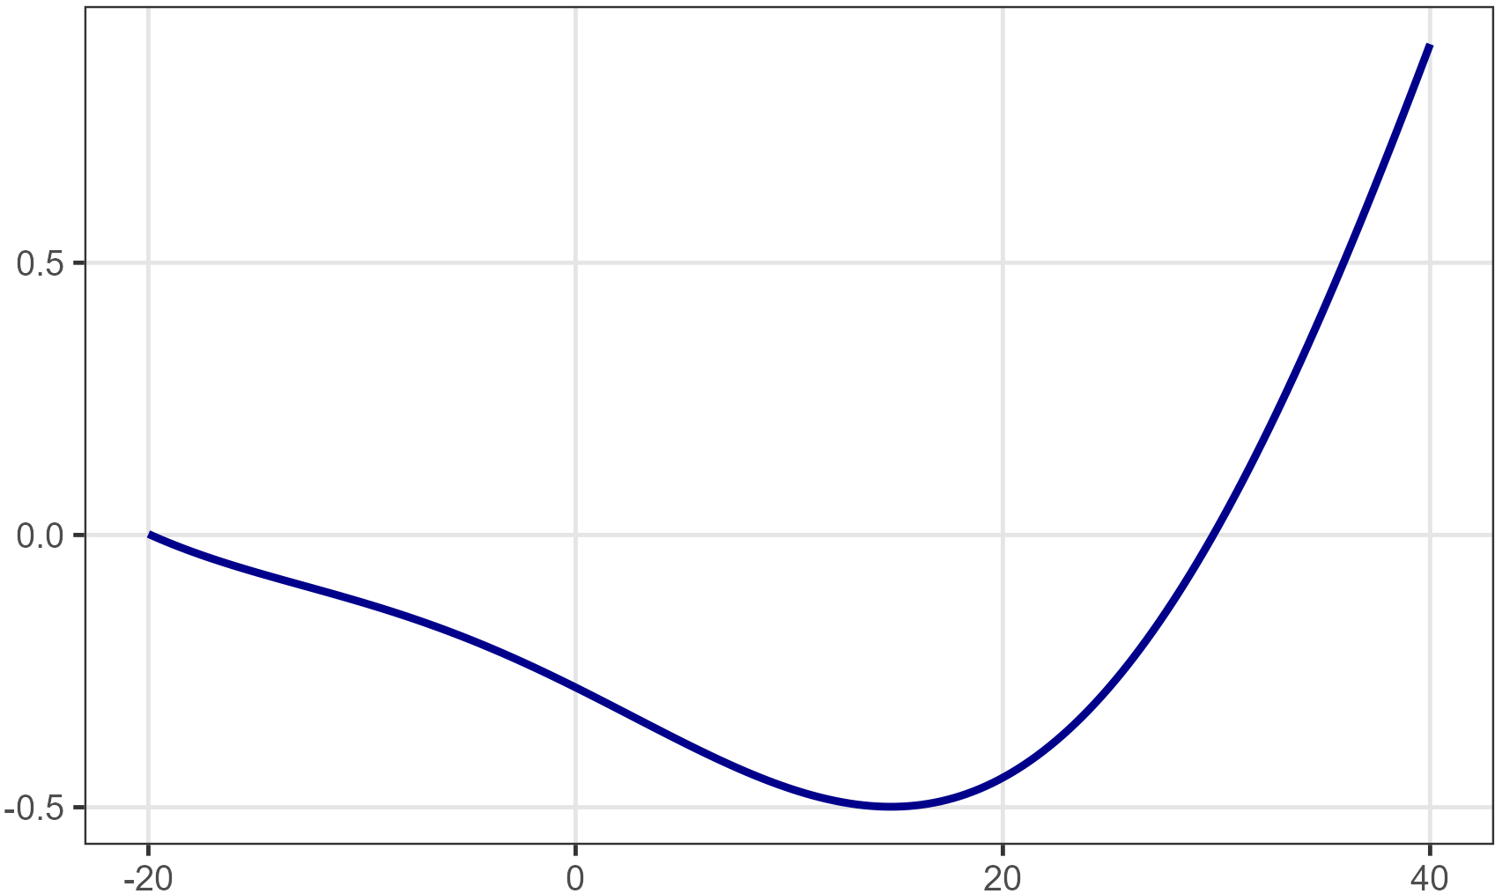
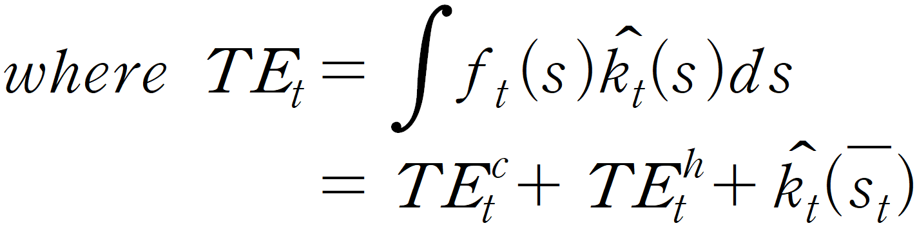
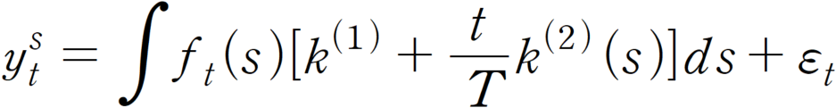
Bridging environment and energy
Research Question
How much electricity can we save by greening our cities?
Green space↑
Heat ↓
Electricity use for cooling ↓
Research Design
(Background) An extended study on the monetary valuation of ecosystem regulating services
(Objective) To estimate the cooling effect of green space and the resulting change in electricity demand for cooling under temperature variation
(Data)
Hourly temperature data (2004-2024, 77 stations nationwide) from ASOS¹⁾ provided by KMA²⁾ retrieved via API³⁾
Monthly electricity consumption by cities and contract type provided by KEPCO⁴⁾
Heat Mitigation impact
using InVEST* model
Temperature response function (TRF)
Electricity demand function
Heat Mitigation
index
City: Suwon,
Tariff: General service
Monthly electricity sales
Monthly effective days
Real electricity tariff index
Monthly GRDP
Monthly temperature effect
TRF
Source: Author
temperature (℃)
ASOS: Automated Synoptic Observing System
KMA: Korea Meteorological administration
API: Application Programming Interface
KEPCO: Korea Electric Power Corporation
Source: Gyeonggi research institute and National Institute of ecology
* InVEST model: Integrated Valuation of Ecosystem Services and Tradeoffs
국립한밭대학교 2025학년도 제1차 전임교원 공개채용 | 경제학과 자원·환경·에너지 분야 | 전 승 호

Slide 13
수업개요
수업 운영 방식
강의 중심의 수업
수업 중 언제든지 어떤 주제도 질문 가능
취식 가능 (냄새만 심하게 안나면)
성적 평가 방법: 상대평가
출석: 10%, 중간고사: 45%, 기말고사 45%
문제풀이 (OX, 객관식, 주관식 포함)
개별 면담
703호 노크해서 내가 자리에 있으면 언제든지 환영
미리 이메일 통해서 약속 잡는 것도 환영
면담내용은 어떤 내용도 환영

Slide 14
Introduction

Slide 15
Positive vs. normative economics
Positive economics
The study of explaining and predicting economic phenomena. It identifies causes and effects without making value judgments.
Example: If a carbon tax is set at 10,000KRW/tCO2, how much will greenhouse gas emissions be reduced?
Normative economics
The study of discussing what is desirable regarding economic policies or situations. It proposes policy directions based on value judgments.
Example: How high should the carbon tax be raised?
Positive -> Normative: Constructive discussions are possible only when empirical results exist, which can then serve as a basis for value judgments.
Environmental economics in my class
In this course, we will study environmental economics within the scope of empirical economics.

Slide 16
What is environment economics?
Microeconomics
The study of how economic agents make decisions—such as production and consumption—based on their motivations.
Macroeconomics
The study of how macroeconomic variables such as GDP, growth rate, unemployment rate, and interest rate are formed and interact.
Environmental economics
The study of how to develop and manage the natural environment or environmental resources by applying economic principles.
How do economic agents affect the natural environment?
How should government policies or economic institutions be designed to balance human consumption needs with the preservation of natural ecosystems?

Slide 17



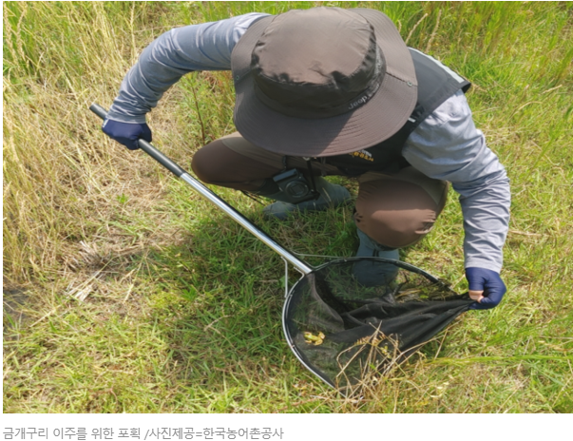
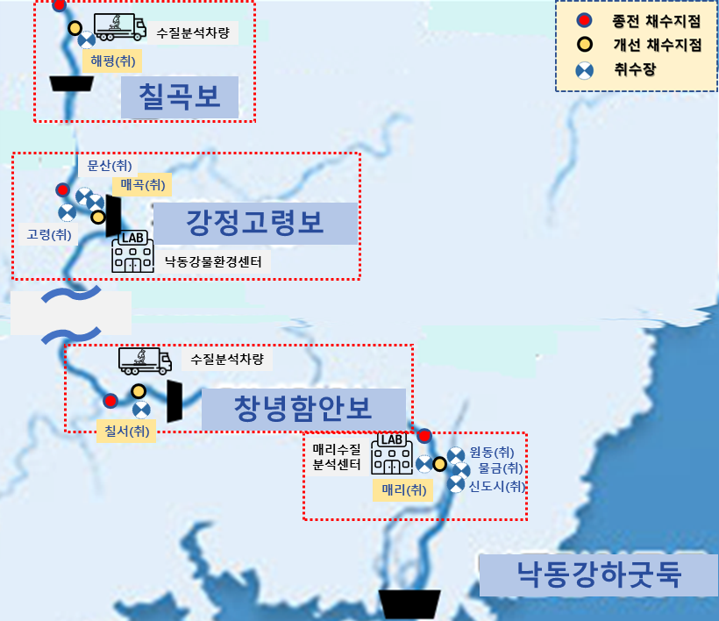
Various topics in environmental economics
https://www.hkbs.co.kr/news/articleView.html?idxno=804644
https://www.hkbs.co.kr/news/articleView.html?idxno=804038

Slide 18


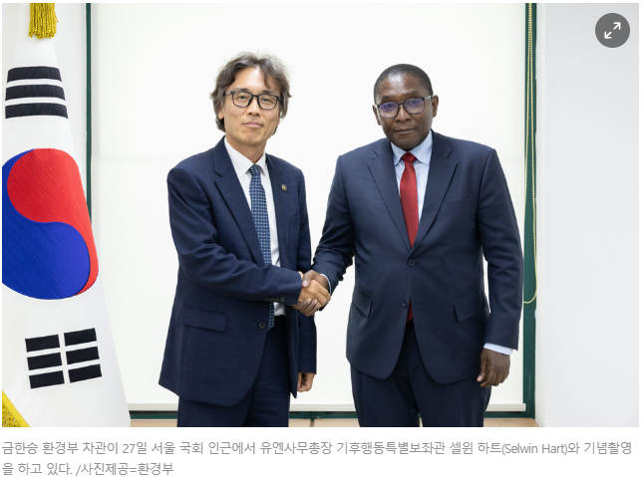
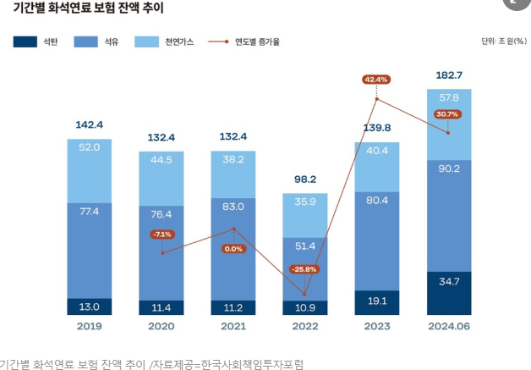
Various topics in environmental economics
https://www.hkbs.co.kr/news/articleView.html?idxno=804655
https://www.hkbs.co.kr/news/articleView.html?idxno=804652

Slide 19
Environmental economics in everyday life
Volume-based Waste Fee System
Before 1995, waste collection fees were charged based on building size or property tax
No economic incentive to reduce waste generation
After 1995, a volume-based waste system was introduced. General waste must be disposed of using designated bags
Since the cost of waste disposal (the price of the designated bags) is proportional to the amount of waste generated, households have an economic incentive to reduce waste.
Extended Producer Responsibility
A system in which producers of products or packaging are required to recycle a certain amount of waste. If they fail to do so, they must pay a recycling fee higher than the actual cost of recycling.
Congestion Pricing
An increase in automobile use raises road congestion, leading to time loss for travelers and higher fuel consumption.

Slide 20
Features in environmental economics
Market failure and externalities
(Public goods) Many goods and services in environmental economics have strong public good characteristics.
Environmental resources often lack private property rights or are owned collectively.
(Externalities) Actions of an economic agent may unintentionally cause benefits or damages to third parties, but such effects are not reflected in market prices.
Bees kept by a beekeeper pollinate nearby orchards, increasing fruit production
A factory discharges wastewater into a river, harming downstream fisheries
Environmental policy
Leaving environmental resource use entirely to market forces can increase environmental damage
To ensure efficient use of environmental resources, economic incentives should be considered
Levying emission charges on pollutants
Setting caps on pollutant emissions

Slide 21
Features in environmental economics
Cost-benefit analysis of environmental policy
When implementing environmental policy, both costs and benefits must be evaluated to provide a basis for policymaking
Unlike market goods, environmental goods often lack explicit prices, making this analysis difficult.
Economic development and environmental preservation
Economic development and environmental preservation were once viewed as conflicting goals.
However, evidence shows that environmental problems are more severe in less-developed countries than in advanced economies.

Slide 22
Economics and natural environment

Slide 23
Interrelationship between economy and environment
Material Balance Approach (Kneese et al., 1970)
Households directly consume services from nature
Enjoyment from beautiful landscapes, clean air
Households also extract various materials and energy from Earth’s natural resources and supply them to the factor market
A farmer provides labor and land to a food company
Firms purchase production factors from the factor market, use them as inputs for final products, and supply outputs to the goods market
A food company uses labor and land to produce flour, which is then supplied back to households
Economic activities generate residuals that are released into nature
Some are absorbed by nature’s assimilative capacity (e.g., composting food waste).
Others remain in the environment as pollutants (e.g., greenhouse gases)
Types of resources supplied by nature
Renewable resources: Flora and fauna, solar energy, wind energy
Non-renewable resources: Oil, coal, metals

Slide 24
Laws of Thermodynamics
First Law of Thermodynamics: Law of Conservation of Energy
Energy can change its form, but its total amount does not change.
Materials or energy extracted from nature can be temporarily delayed through recycling or reuse, but they are ultimately converted into the same amount of waste and returned to nature.
Second Law of Thermodynamics: Law of Increase of Entropy
Entropy always increases or is maintained. Heat flows from a high temperature to a low temperature.
Hot coffee cools down on its own, but cold coffee does not get hot on its own.
(Types of resources) Resources supplied by nature can be classified into two types.
Renewable resources: animals and plants, solar, wind
Non-renewable resources: oil, coal, metals

Slide 25
Basic Terminology Related to Environmental Pollution
Environmental quality
Expresses the qualitative state of the natural environment. It is a very broad concept that includes pollution levels, natural scenery, etc.
Residuals
Materials remaining after the production or consumption process of an output. (Industrial waste: materials remaining from the production process, household waste: materials remaining from the consumption process)
Pollutant
A substance or energy that degrades environmental quality when released into nature.
Emission
The amount of pollutants among residuals that have been released into nature.
Sources
The location where pollutants are emitted (e.g., factories, automobiles, landfills)
Damages
The negative effects of environmental pollution on people and ecosystems (deterioration of human health, extinction of flora and fauna (animals and plants)).
Environmental medium
Elements that constitute the natural environment (e.g., land, water, air).

Slide 26
Types of Pollutants
Accumulative and Non-accumulative Pollutants
Classified according to whether they remain and accumulate for a long time after being released into nature, or disappear.
Accumulative pollutants: carbon dioxide, methane, lead, heavy metals
Non-accumulative pollutants: noise, bad smell, light pollution
Self-regulating ability of Ecosystems
Nature has the ability to absorb and break down a certain amount of pollutants
When pollutants are emitted beyond the self-regulating ability of the ecosystem, they accumulate in nature.
Climate change is caused by carbon emissions consistently exceeding carbon absorption.
The situation where carbon emissions and carbon absorption are equal is called carbon neutrality.

Slide 27
Types of Pollutants
Local, Regional, and Transboundary Pollutants
(Local) Pollutants that affect only the vicinity of a specific area.
carbon monoxide (CO) from cars and heating boilers shows high concentrations only nearby
(Regional) Pollutants that affect urban or metropolitan areas
Acid rain is mainly caused by substances like SO₂ and NOx, and it travels more than several hundred kilometers
A case where acid rain falls in Daejeon due to pollutants emitted by vehicles driving in Seoul.
(Transboundary) Pollutants that cross borders and affect other countries
the case of yellow dust originating from the Gobi Desert in Mongolia and affecting Korea and Japan
Greenhouse gases are causing climate change across the entire planet.

Slide 28
Types of Pollutants
Land pollutants and Global pollutants
(Land) Pollutants that accumulate on the surface and destroy the environment.
(Global) Pollutants that accumulate in the atmosphere and destroy the environment of the entire planet.
Point source and Nonpoint source Pollutants
(Point source) Cases where pollutants are emitted through a single point
air pollutants from factory smokestacks
discharge of cooling water from power plants
(Nonpoint Source Pollutants) Cases where pollutants are emitted from a wide area
nitrogen and phosphorus washed away by rainwater from farmland (components of fertilizers and pesticides)
soil runoff from forests
Continuous and Intermittent Pollution
(Continuous) Cases where pollutants are emitted steadily (power plant operation, car traffic)
(Intermittent) Cases where pollutants are emitted irregularly and intermittently (radioactive leakage due to an accident, oil tanker accident)

Slide 29
Thank you

